Slide 1
Data Cleaning and EDA
Exploratory data analysis and its role in the data science lifecycle.
Acknowledgment :Anthony D. Joseph and Fernando Pérez

Slide 2

Previously …
http://abcnews.go.com/Lifestyle/silly-baby-panda-falls-flat-face-public-debut/story?id=42481478

Slide 3
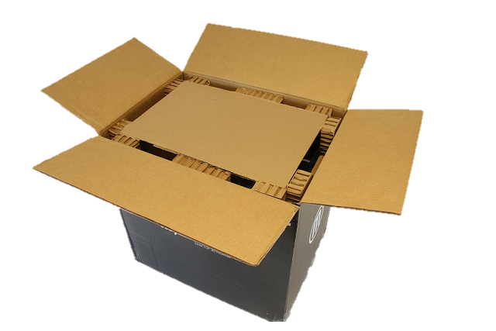
Congratulations!
You have collected or been given a box of data?
Box of Data
What do you do next?

Slide 4


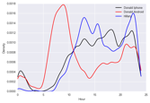
Question & Problem Formulation
?
Data Acquisition
Prediction and Inference
Exploratory Data Analysis

Slide 5
Data Cleaning
Exploratory Data
Analysis
… the infinite loop of data science.

Slide 6
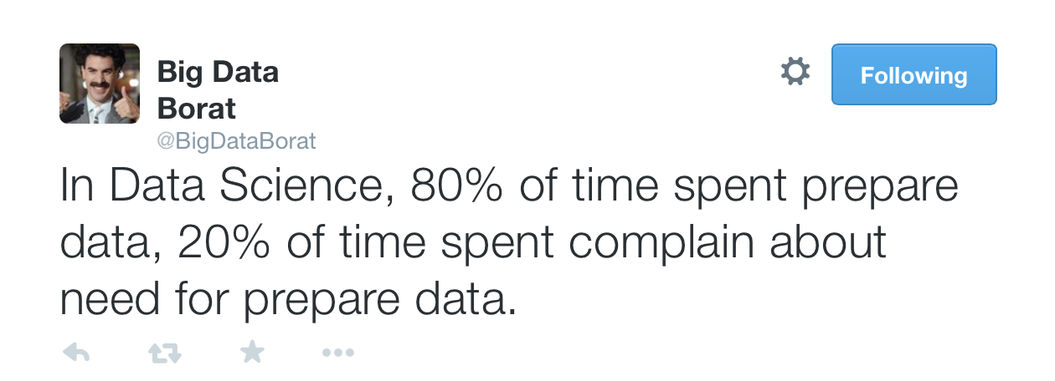
Data Cleaning
The process of transforming raw data to facilitate subsequent analysis
Data cleaning often addresses issues
structure / formatting
missing or corrupted values
unit conversion
encoding text as numbers
…
Sadly, data cleaning is a big part of data science…

Slide 7
Data Cleaning

Slide 8
Data Cleaning
Exploratory Data
Analysis
… the infinite loop of data science.

Slide 9
(EDA)
Exploratory Data Analysis
“Getting to know the data”
The process of transforming, visualizing, and summarizing data to:
Build/confirm understanding of the data and its provenance
Identify and address potential issues in the data
Inform the subsequent analysis
discover potential hypothesis … (be careful)
EDA is an open-ended analysis
Be willing to find something surprising

Slide 10

John Tukey
Princeton Mathematician & Statistician
Introduced
Fast Fourier Transform
“Bit” : binary digit
Exploratory Data Analysis
Early Data Scientist
Data Analysis & Statistics, Tukey 1965
Image from LIFE Magazine
Notes:
John Tukey, Princeton mathematician and statistician, inventor of the Fast Fourier Transform and father of Exploratory Data Analysis. Also coined the word “bit”.
Emphasis courtesy Jeff Heer, U. Washington

Slide 11
EDA is like detective work
“Exploratory data analysis is an attitude, a state of flexibility, a willingness to look for those things that we believe are not there, as well as those that we believe to be there.”
Data Analysis & Statistics, Tukey 1965
Image from LIFE Magazine
Notes:
Contrast to confirmatory data analysis (statistical hypothesis testing)

Slide 13
File Formats and Structure

Slide 14
What should we look for?

Slide 15
Key Data Properties to Consider in EDA
Structure -- the “shape” of a data file
Granularity -- how fine/coarse is each datum
Scope -- how (in)complete is the data
Temporality -- how is the data situated in time
Faithfulness -- how well does the data capture “reality”

Slide 16
Key Data Properties to Consider in EDA
Structure -- the “shape” of a data file
Granularity -- how fine/coarse is each datum
Scope -- how (in)complete is the data
Temporality -- how is the data situated in time
Faithfulness -- how well does the data capture “reality”

Slide 17
Rectangular Data
Fields/Attributes/ Features/Columns
We prefer rectangular data for data analysis (why?)
Regular structures are easy manipulate and analyze
A big part of data cleaning is about transforming data to be more rectangular
Two kinds of rectangular data: Tables and Matrices
(what are the differences?)
Records/Rows

Slide 18
Rectangular Data
Fields/Attributes/ Features/Columns
We prefer rectangular data for data analysis (why?)
Regular structures are easy manipulate and analyze
A big part of data cleaning is about transforming data to be more rectangular
Two kinds of rectangular data: Tables and Matrices
(what are the differences?)
Tables (a.k.a. data-frames in R/Python and relations in SQL)
Named columns with different types
Manipulated using data transformation languages (map, filter, group by, join, …)
Matrices
Numeric data of the same type
Manipulated using linear algebra
Records/Rows

Slide 19
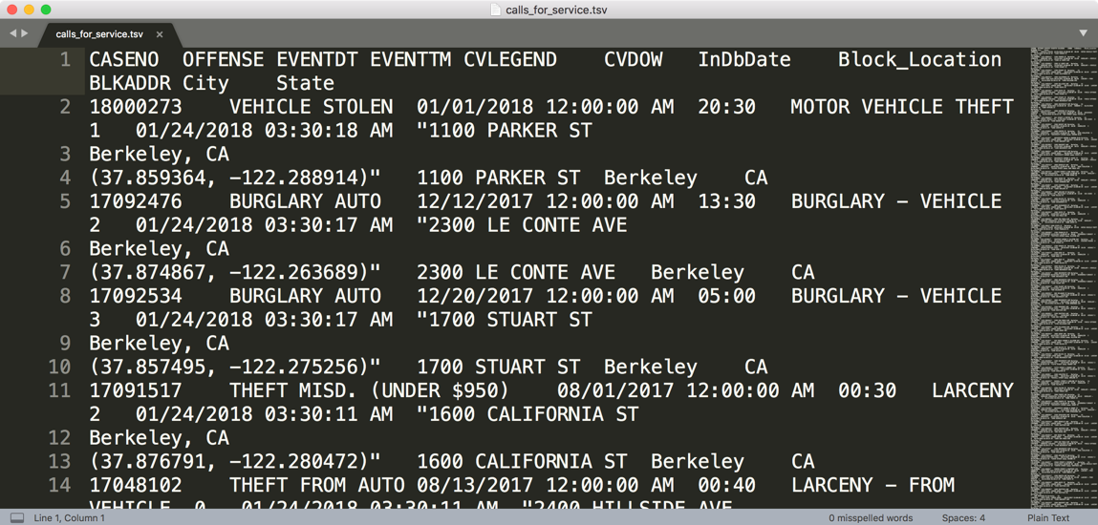
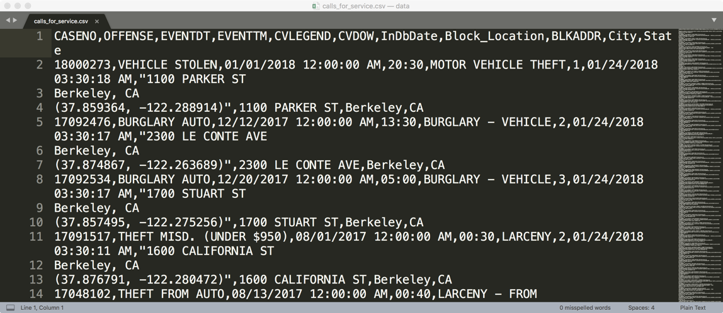
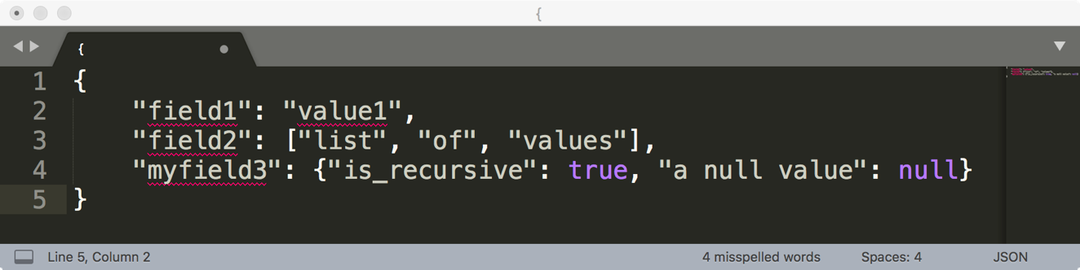
How are these data files formatted?
TSV
Tab separated values
Which is the best?
CSV
Comma separated values
JSON

Slide 20
Comma and Tab Separated Values Files
Tabular data where
Records are delimited by a newline: “\n”, “\r\n”
Fields are delimited by ‘,’ (comma) or ‘\t’ (tab)
Very Common!
Issues?
Commas, tabs in records
Quoting
…

Slide 21
JavaScript Object Notation (JSON)
Widely used file format for nested data
Very similar to python dictionaries
Strict formatting ”quoting” addresses some issues in CSV/TSV
Issues
Not rectangular
Each record can have different fields
Nesting means records can contain tables – complicated

Slide 22
Extensible Markup Language - XML (another kind of nested data)
<catalog>
<plant type='a'>
<common>Bloodroot</common>
<botanical>Sanguinaria canadensis</botanical>
<zone>4</zone>
<light>Mostly Shady</light>
<price>2.44</price>
<availability>03/15/2006</availability>
<description>
<color>white</color>
<petals>true</petals>
</description>
<indoor>true</indoor>
</plant>
…
</catalog>
Nested structure
Notes:
anything in brackets is markup; only 4 pieces of information

Slide 23
Log Data
Is this a csv file? tsv?
JSON/XML?
169.237.46.168 - - [26/Jan/2014:10:47:58 -0800] "GET /stat141/Winter04 HTTP/1.1" 301 328 "http://anson.ucdavis.edu/courses/" "Mozilla/4.0 (compatible; MSIE 6.0; Windows NT 5.0; .NET CLR 1.1.4322)”
169.237.6.168 - - [8/Jan/2014:10:47:58 -0800] "GET /stat141/Winter04/ HTTP/1.1" 200 2585 "http://anson.ucdavis.edu/courses/" "Mozilla/4.0 (compatible; MSIE 6.0; Windows NT 5.0; .NET CLR 1.1.4322)"

Slide 25
Keys and Joins

Slide 26
Structure: Keys
Primary Key
Purchases.csv
OrderNum | ProdID | Quantity
1 | 42 | 3
1 | 999 | 2
2 | 42 | 1
Often data will reference other pieces of data
Primary key: the column or set of columns in a table that determine the values of the remaining columns
Primary keys are unique
Examples: SSN, ProductIDs, …
Orders.csv
OrderNum | CustID | Date
1 | 171345 | 8/21/2017
2 | 281139 | 8/30/2017
Products.csv
ProdID | Cost
42 | 3.14
999 | 2.72
Primary Key
Customers.csv
CustID | Addr
171345 | Harmon..
281139 | Main ..

Slide 27
Structure: Keys
Primary Key
Purchases.csv
OrderNum | ProdID | Quantity
1 | 42 | 3
1 | 999 | 2
2 | 42 | 1
Often data will reference other pieces of data
Primary key: the column or set of columns in a table that determine the values of the remaining columns
Primary keys are unique
Examples: SSN, ProductIDs, …
Foreign keys: the column or sets of columns that reference primary keys in other tables.
You will need to join across tables
Foreign Key
Orders.csv
OrderNum | CustID | Date
1 | 171345 | 8/21/2017
2 | 281139 | 8/30/2017
Products.csv
ProdID | Cost
42 | 3.14
999 | 2.72
Primary Key
Customers.csv
CustID | Addr
171345 | Harmon..
281139 | Main ..

Slide 28
Questions to ask about Structure
Are the data in a standard format or encoding?
Tabular data: CSV, TSV, Excel, SQL
Nested data: JSON or XML
Are the data organized in “records”?
No: Can we define records by parsing the data?
Are the data nested? (records contained within records…)
Yes: Can we reasonably un-nest the data?
Does the data reference other data?
Yes: can we join/merge the data
What are the fields in each record?
How are they encoded? (e.g., strings, numbers, binary, dates …)
What is the type of the data?

Slide 30
Variable Types

Slide 31
Variable
Note that categorical variables can have numeric levels and quantitative variables may be stored as strings.
Ratios and intervals have meaning.
Quantitative
Qualitative
Continuous
Discrete
Ordinal
Nominal
Could be measured to arbitrary precision.
Finite possible values
Categories w/ levels but no consistent meaning to difference
Categories w/ no
specific ordering.
Examples:
Price
Temperature
Examples:
Number of siblings
Yrs of education
Examples:
Preferences
Level of education
Examples:
Political Affiliation
CallD number

Slide 32
What is the type of variable?
 | Quantitative Continuous | Quantitative Discrete | Qualitative Ordinal | Qualitative Nominal
CO₂ level (PPM)
Number of siblings
GPA
Income bracket (low, med, high)
Race
Number of years of education
Yelp Rating

Slide 34
Granularity, Scope, and Temporality

Slide 35
Key Data Properties to Consider in EDA
Structure -- the “shape” of a data file
Granularity -- how fine/coarse is each datum
Scope -- how (in)complete is the data
Temporality -- how is the data situated in time
Faithfulness -- how well does the data capture “reality”

Slide 36
Key Data Properties to Consider in EDA
Structure -- the “shape” of a data file
Granularity -- how fine/coarse is each datum
Scope -- how (in)complete is the data
Temporality -- how is the data situated in time
Faithfulness -- how well does the data capture “reality”

Slide 37
Granularity
Rec. 1
Rec. 1
Rec. 2
Rec. 3
Rec. 1
Rec. 2
Rec. 3
Fine Grained
Coarse
Grained
What does each record represent?
Examples: a purchase, a person, a group of users
Do all records capture granularity at the same level?
Some data will include summaries (aka rollups) as records
If the data are coarse how was it aggregated?
Sampling, averaging, …

Slide 38
Key Data Properties to Consider in EDA
Structure -- the “shape” of a data file
Granularity -- how fine/coarse is each datum
Scope -- how (in)complete is the data
Temporality -- how is the data situated in time
Faithfulness -- how well does the data capture “reality”

Slide 39
Key Data Properties to Consider in EDA
Structure -- the “shape” of a data file
Granularity -- how fine/coarse is each datum
Scope -- how (in)complete is the data
Temporality -- how is the data situated in time
Faithfulness -- how well does the data capture “reality”

Slide 40
Scope
Does my data cover my area of interest?
Example: I am interested in studying crime in California but I only have Berkeley crime data.
Is my data too expansive?
Example: I am interested in student grades for DS100 but have student grades for all statistics classes.
Solution: Filtering ⇒ Implications on sample?
If the data is a sample I may have poor coverage after filtering …
Does my data cover the right time frame?
More on this in temporality …

Slide 41
Revisiting the Sampling Frame
The sampling frame is the population from which the data was sampled.
Note that this may not be the population of interest.
How complete/incomplete is the frame (and its data)?
How is the frame/data situated in place?
How well does the frame/data capture reality?
How is the frame/data situated in time?

Slide 42
Key Data Properties to Consider in EDA
Structure -- the “shape” of a data file
Granularity -- how fine/coarse is each datum
Scope -- how (in)complete is the data
Temporality -- how is the data situated in time
Faithfulness -- how well does the data capture “reality”

Slide 43
Key Data Properties to Consider in EDA
Structure -- the “shape” of a data file
Granularity -- how fine/coarse is each datum
Scope -- how (in)complete is the data
Temporality -- how is the data situated in time
Faithfulness -- how well does the data capture “reality”

Slide 44
Temporality
Data changes – when was the data collected?
What is the meaning of the time and date fields?
When the “event” happened?
When the data was collected or was entered into the system?
Date the data was copied into a database (look for many matching timestamps)
Time depends on where! (Time zones & daylight savings)
Learn to use datetime python library
Multiple string representation (depends on region): 07/08/09?
Are there strange null values?
January 1st 1970, January 1st 1900
Is there periodicity? Diurnal patterns

Slide 45
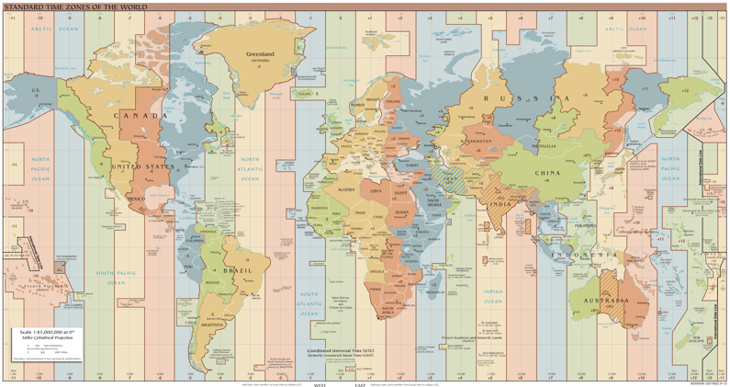
Unix Time / POSIX Time
Time measured in seconds since January 1st 1970
Minus leap seconds …
Unix time follows Coordinated Universal Time (UTC)
International time standard
Measured at 0 degrees latitude
Similar to Greenwich Mean Time (GMT)
No daylight savings
Time codes
Time Zones:
San Francisco (UTC-8) without daylight savings
https://en.wikipedia.org/wiki/Coordinated_Universal_Time
Notes:
Year 2038 problem 🡪 32 bit signed time wraps around.

Slide 47
Faithfulness and Missing Values

Slide 48
Key Data Properties to Consider in EDA
Structure -- the “shape” of a data file
Granularity -- how fine/coarse is each datum
Scope -- how (in)complete is the data
Temporality -- how is the data situated in time
Faithfulness -- how well does the data capture “reality”

Slide 49
Key Data Properties to Consider in EDA
Structure -- the “shape” of a data file
Granularity -- how fine/coarse is each datum
Scope -- how (in)complete is the data
Temporality -- how is the data situated in time
Faithfulness -- how well does the data capture “reality”

Slide 50
Faithfulness: Do I trust this data?
Does my data contain unrealistic or “incorrect” values?
Dates in the future for events in the past
Locations that don’t exist
Negative counts
Misspellings of names
Large outliers
Does my data violate obvious dependencies?
E.g., age and birthday don’t match
Was the data entered by hand?
Spelling errors, fields shifted …
Did the form require fields or provide default values?
Are there obvious signs of data falsification:
Repeated names, fake looking email addresses, repeated use of uncommon names or fields.

Slide 51
Signs that your data may not be faithful
Missing Values/Default values?
What do they look like?
“ “,
0,
-1, 999, 12345,
NaN, Null,
1970, 1900
Notes:
Negative numbers, large outliers, failed parsing …

Slide 52
What to do with the Missing Values?
Drop records with missing values
Probably most common
Caution: check for biases introduced by dropped values
Missing or corrupt records might be related to something of interest
Imputation: (Inferring missing values)
Mean Imputation: replace with an average value
Which mean? Often use closest related subgroup mean.
Hot deck imputation: replace with a random value
Choose a random value from the subgroup and use it for the missing value.
Prof. Gonzalez Suggestion:
Drop missing values but check for induced bias (use domain knowledge)
Directly model missing values during future analysis

Slide 53
Signs that your data may not be faithful
Missing Values or default values
Truncated data (early excel limits: 65536 Rows, 255 Columns)
Soln: be aware of consequences in analysis ⇒ how did truncation affect sample?
Time Zone Inconsistencies
Soln 1: convert to a common timezone (e.g., UTC)
Soln 2: convert to the timezone of the location – useful in modeling behavior.
Duplicated Records or Fields
Soln: identify and eliminate (use primary key) ⇒ implications on sample?
Spelling Errors
Soln: Apply corrections or drop records not in a dictionary ⇒ implications on sample?
Units not specified or consistent
Solns: Infer units, check values are in reasonable ranges for data
Others…
Notes:
Negative numbers, large outliers, failed parsing …

Slide 55
Summary

Slide 56
Summary: How do you do EDA/Data Cleaning?
Examine data and metadata:
What is the date, size, organization, and structure of the data?
Examine each field/attribute/dimension individually
Examine pairs of related dimensions
Stratifying earlier analysis: break down grades by major …
Along the way:
Visualize/summarize the data
Validate assumptions about data and collection process
Identify and address anomalies
Apply data transformations and corrections
Record everything you do! (why?)

